Slide 1
CMPH-200
Microprocessors 4
I/O and Interrupts
November 2000
©Paul R. Godin
and SAIT

Slide 2
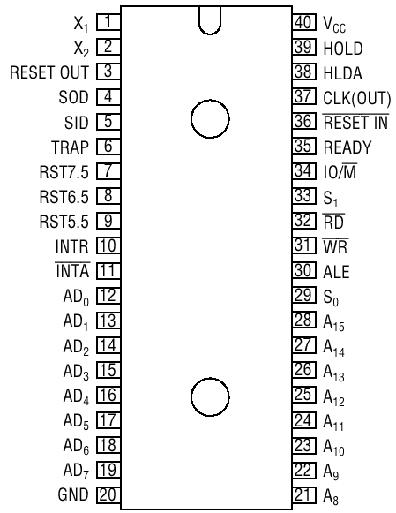

Slide 3
Externally Initiated Operations
There are individual pins on the microprocessor that can be externally controlled to initiate certain operations.
These include:
  Reset
  Ready
  Hold
  Interrupt

Slide 4
Reset
The 8085, like most microprocessors, has a reset input.
When the reset is applied, all microprocessor operations are immediately stopped and the PC is cleared.
The program counter begins again at the 0000 address.
The 8085 has a reset acknowledge output that can be used to reset other devices if necessary.

Slide 5
Ready
The ready input is utilized by slower devices.
The input is held low it other devices require more time to complete an instruction.
The microprocessor enters into a wait state.

Slide 6
Hold
The hold input to the microprocessor is used by other devices to request the microprocessor relinquish control of the buses.
This is used for devices that may need access to those buses.
The HLDA output is an acknowledgement provided by the microprocessor stating it is in a hold condition.

Slide 7
Interrupt
The microprocessor can be interrupted from its normal operations to execute other instructions.
INTR is an input (note error on specification sheet) utilized to request an interrupt, or a break in the routine.
The INTR input is enabled or disabled by an instruction (EI or DI).

Slide 8
Masking
A maskable interrupt is an interrupt request that may be ignored until the microprocessor has completed its current task.
A non-maskable interrupt is one that causes the microprocessor to immediately stop its current task.

Slide 9
I/O

Slide 10
I/O Interfacing
To interface with I/O devices, latches in the microcomputer are used.
These latches retain the data for use by either the microprocessor or the I/O device.
Look at the microcomputer circuit diagram and determine how the I/O latches are physically controlled.

Slide 11
Control of the I/O Latch
The I/O latch is tied to the 8 bit data bus. The microprocessor controls the I/O latches through the use of instructions.
In peripheral-mapped I/O, the I/O latch is enabled through the use of an 8-bit address and control lines. In memory-mapped I/O, the I/O latch is enabled through the use of a 16-bit address and memory-related controls.
The SOD output and the SID input pins, as well as addresses, provide the hardware control to the I/O latches.

Slide 12
Parallel Interfacing
The transfer of data between the I/O latch and the I/O device can be either parallel or serial.
PIPO Register
I/O Device
PISO Register
I/O Device
Parallel
Serial

Slide 13
End
November 2000
©Paul R. Godin
All Rights Reserved
godin@tcel.com
3H

